Slide 1
Confluence Parkway Funding Request
February 3, 2022
Frank Kuntz Jeff Wilkens Richard DeRock
Mayor Executive Director General Manager
City of Wenatchee Chelan-Douglas Transportation Council LINK Transit

Slide 2
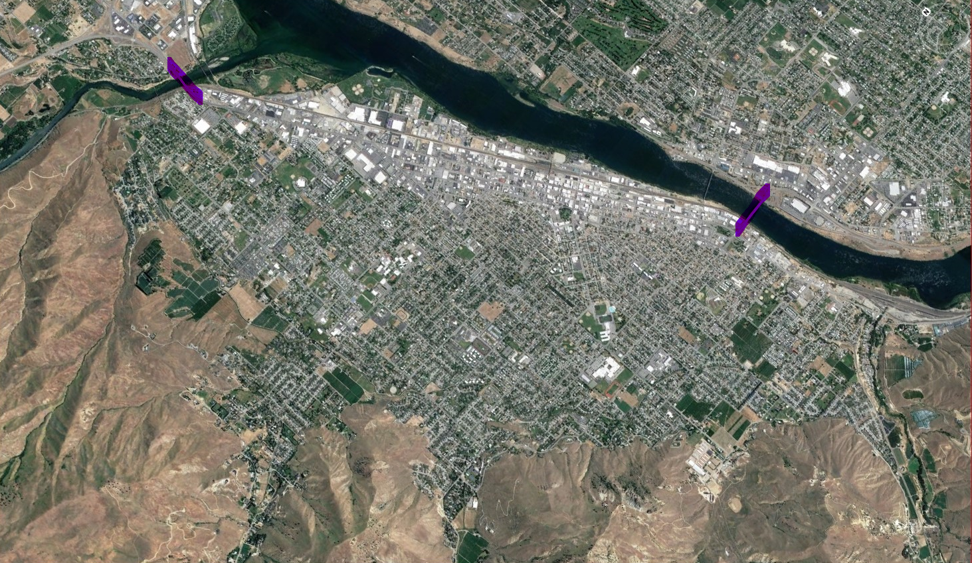
Wenatchee is landlocked between mountains and rivers.
Only (2) ways on and off the “island” – major risk for a wildfire disaster evacuation scenario.

Slide 3
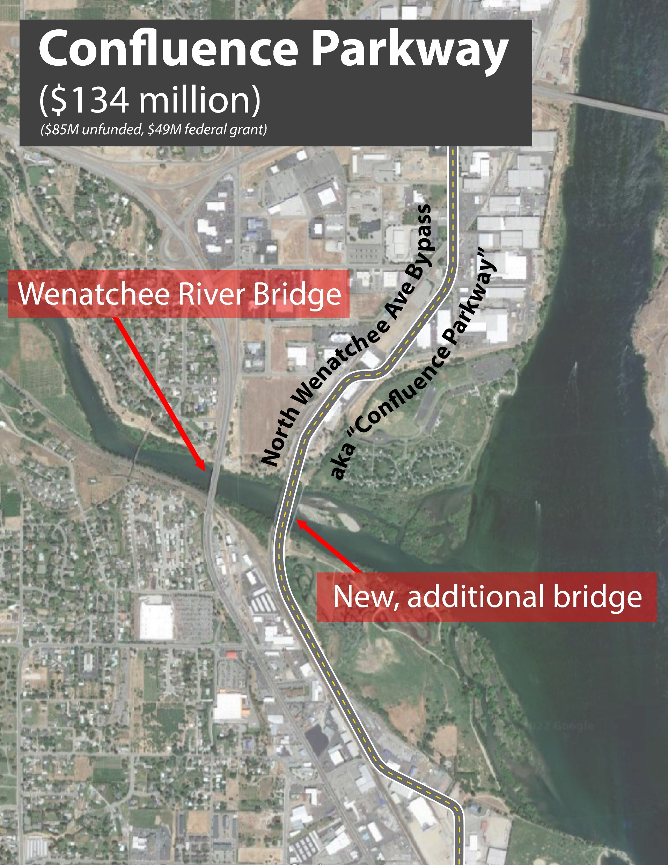
Confluence Parkway
The top priority in the Regional Transportation Plan for over a decade. Funding was included in the Forward Washington and Miles Ahead project lists.
Other secured, INFRA-funded improvements:
$10 million secured for South Wenatchee ped/bike connections to Loop Trail over BNSF railroad and SR 28.
$33 million secured for BNSF railroad underpass connecting SR 285 and Confluence Parkway.
$134 million Total Project Cost
- $49 million Secured Federal INFRA Grant
$85 million Unfunded
Notes:
Confluence Parkway is a 2.5-mile bypass corridor that extends from the U.S. 2/Euclid Avenue interchange, crosses the Wenatchee River on a new bridge, and extends south to the intersection of North Miller Street and SR 285/North Wenatchee Avenue.
Play CP North to South and Aerial – City has received $92 million in INFRA funding to implement the project. While the project is partially funded, per federal regulations, the project for the purposes of our environmental assessment includes the entire bypass corridor.

Slide 4
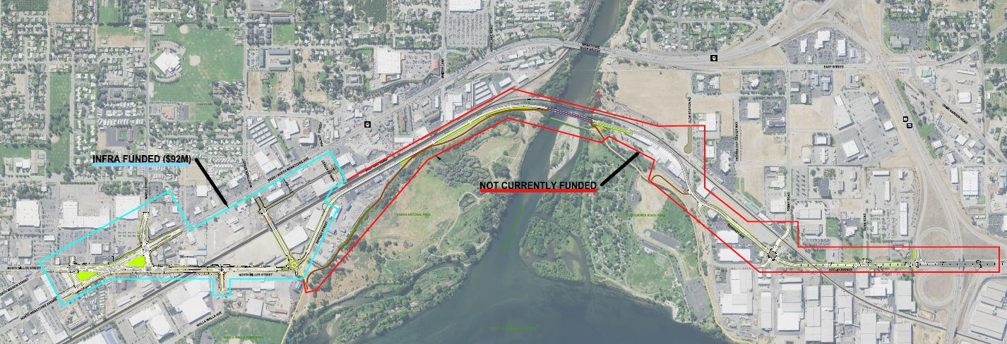
Confluence Parkway – Project Overview

Slide 5
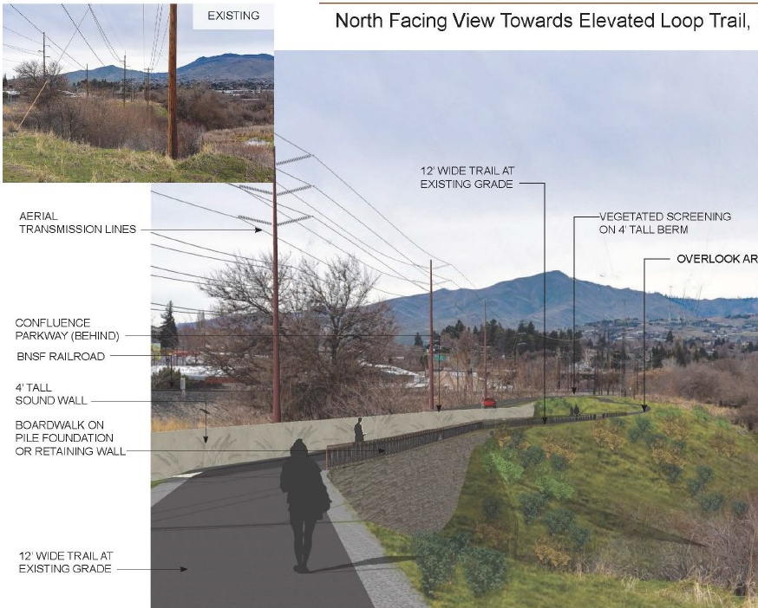
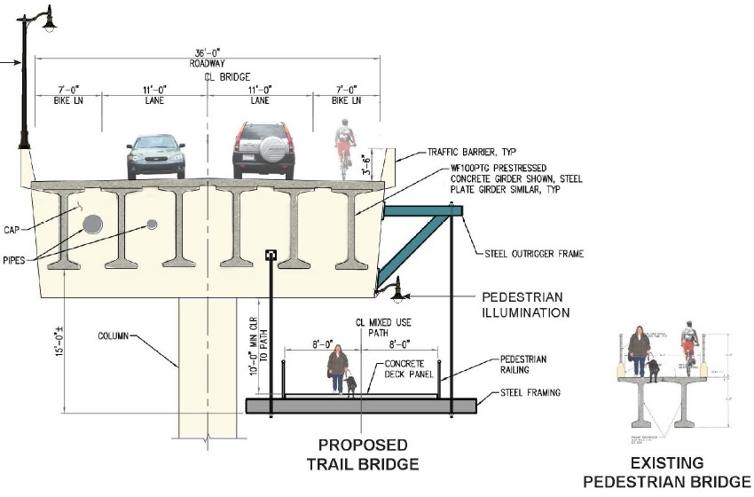
Project Includes “Loop Trail” Improvements
Realignment away from BNSF railroad
Integrated with INFRA funding for new South-End neighborhood connections to Loop Trail
Replaces 8’ wide Wenatchee River trail bridge with new 16’ wide bridge + new bike lanes

Slide 6
The Unique Case for State Investment
Confluence Parkway is one of the last major components of the $230 million “Apple Capital Loop” initiative - a regional, multimodal transportation system project.
USDOT recognized it in 2021 with a $92 million INFRA grant award – highest in the nation.
We are down to an $85 million gap for the Confluence Parkway section.
Key local funding challenge ➔ all available local match committed to the INFRA grant. This severely limits our ability to pursue a 2nd federal grant.
City has a time-critical opportunity to construct project on the INFRA grant timeline:
21-23 biennium - $10 million
23-25 biennium - $40 million requested appropriations for project delivery
25-27 biennium - $35 million

Slide 7
The Unique Case for State Investment
Not a typical highway project - it does address a traffic chokepoint but is equally important for other reasons:
Creates 3rd point of access/egress for a landlocked city – critical for daily emergency response and evacuation of 40,000 people if another wildfire strikes.
Enables infill and compact development in central city and along waterfront – the opposite of a typical highway sprawl project. This is what the GMA askes of us.
Missing link for creating express bus service to Leavenworth and Chelan, and for urban area bus routes to be a more competitive alternative to driving.

Slide 8
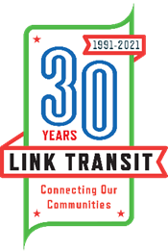
Confluence Parkway is a Transit Investment
Creates savings that can be converted into more transit services:
3,063 annual service hours saved due to shorter distance
12,028 annual service hours saved by less congestion
@ current $125 per hour cost = $1,887,000 annual savings

Slide 9
Confluence Parkway is a Transit Investment
Improves transit operations:
58,200 annual miles saved due to shorter distances
156,364 annual passenger travel delay hours saved
Peak hour travel time reduced by 14 minutes
Key for proposed Leavenworth to Wenatchee Bus Rapid Transit

Slide 10
The Unique Case for State Investment
Wenatchee Metro Area doesn’t benefit from federal and state investment in an interstate or 4-lane freeway.
(1) of only (8) disconnected metro areas in the nation.
WSDOT’s priority in North Central Washington is pavement and bridge preservation on rural highways.

Slide 11
Thank you!
Please close the remaining $85 million funding gap for Wenatchee’s Confluence Parkway Project!
For more information on confluence parkway:
Website: Confluence parkway
Email: cpnepa@wenatcheewa.gov

